Slide 1

Ensuring Educational Stability for Children in Foster Care:
An Overview of the ED/HHS Joint Guidance
July 27, 2016

Slide 2
Today’s Presenters
Mary Myslewicz
Casey Fellow, Office of Planning, Evaluation, and Policy Development, U.S. Department of Education
Kelly Fitzpatrick
Policy Advisor, Office of Planning, Evaluation, and Policy Development, U.S. Department of Education
Stevi Steines
Chief Deputy, Administration on Children, Youth and Families, U.S. Department of Health and Human Services
Kathleen McNaught
Project Director, Legal Center for Foster Care and Education, ABA Center on Children and the Law

Slide 3
Today’s Agenda
Provide an overview of the Fostering Connections to Success and Increasing Adoptions Act of 2008 and the Every Student Succeeds Act of 2015
Provide an overview of the HHS/ED joint guidance on ensuring educational stability for children in foster care
Highlight next steps for collaboration and implementation
Q&A

Slide 4
Children in Foster Care
Educational Outcomes
Children in foster care are often a vulnerable and highly mobile student population
Children in foster care typically make more unscheduled school changes than their peers in a given school year
Compared to their peers, students in foster care experience:
  LOWER high school graduation rates
  LOWER scores on academic assessments
  HIGHER rates of grade retention, chronic absenteeism, suspensions, and expulsions

Slide 5
Legislative Framework

Slide 6
Fostering connections to Success and Increasing Adoptions Act of 2008
Title IV-B/IV-E agencies must make assurances that:
The child’s placement takes into account the appropriateness of the current educational setting and the proximity to the school of origin;
The agency has coordinated with local education agencies (LEAs) to ensure that a child in foster care remains in his or her school of origin if it is in the child’s best interest; and
If remaining at the school of origin is not in the child’s best interest, the child is immediately enrolled in a new school and records are transferred to the new school

Slide 7
Every Student Succeeds Act of 2015
Reauthorizes and amends the Elementary and Secondary Education Act of 1965 (ESEA)
Requires States to report on achievement and graduation rates for children in foster care
Includes new foster care provisions that complement requirements in the Fostering Connections Act
  Emphasizes shared agency responsibility/decision-making
  All education stability provisions must be implemented by December 10, 2016

Slide 8
Educational Stability
Joint Guidance

Slide 9
Joint Guidance: An Overview
Table of Contents
Educational Stability | Questions 1 – 9
School of Origin | Questions 10 – 11
Best Interest Determination | Questions 12 – 17
Dispute Resolution | Questions 18 – 20
Transportation | Questions 21 – 32
Immediate Enrollment/Records Transfer | Question 33
Points of Contact (POCs) | Questions 34 – 37
Student Data and Privacy | Question 38
Collaboration | Questions 39 – 40
Access the joint guidance here:
http://www2.ed.gov/policy/elsec/leg/essa/edhhsfostercarenonregulatorguide.pdf

Slide 10
Best interest determinations
ESSA requirements
SEAs must provide assurances that:
Children in foster care enroll or remain in the school of origin unless there is a determination that it is not in his or her best interest to attend the school of origin
The best interest determination must be based on all factors, including:
  Appropriateness of the current educational setting
  Proximity to the school in which the child is enrolled at the time of placement

Slide 11
Best interest determinations
Guidance provisions
SEAs and State CWAs should establish uniform guidelines for local agencies
LEAs and local CWAs should collaborate to develop a joint process for making best interest determinations
Should consider multiple student-centered factors
  Transportation costs should not be a factor
Should consult child, if appropriate, and adults who have meaningful relationships with child

Slide 12
Best interest determinations
Guidance provisions
If they can’t come to agreement, ultimate decision should reside with the CWA
SEAs and LEAs should coordinate with CWAs to develop a dispute resolution process
To the extent feasible and appropriate, a child must remain in his or her school of origin while awaiting a decision to reduce the number of school moves

Slide 13
Transportation procedures
ESSA Requirements
LEAs must provide assurances that they will collaborate with State or local CWAs to:
Develop and implement clear written procedures for how transportation will be provided, arranged, and funded for the duration of the time in foster care
Procedures must ensure that children will promptly receive transportation in a cost-effective manner in accordance with the Fostering Connections Act
Ensure that, if there are additional costs incurred in providing transportation to the school of origin, LEAs will provide transportation if:
  The local CWA agrees to reimburse the LEA;
  The LEA agrees to pay the cost; or
  The LEA and local CWA agree to share the cost.

Slide 14
Transportation requirements
Guidance provisions
Transportation must be provided in a “cost-effective” manner, so low-cost/no-cost options should be explored
Even if an LEA doesn’t transport other students, it must ensure that transportation is provided to children in foster care consistent with procedures developed in collaboration with CWAs
Transportation is an allowable use of federal funds, both under Title IV-E of the Social Security Act and Title I of the ESEA
All funding sources should be maximized to ensure costs are not unduly burdensome on one agency

Slide 15
Transportation requirements
Guidance provisions
LEAs and CWAs should work together to agree on costs
Transportation procedures should include a dispute resolution process if parties can’t come to agreement
SEAs and State CWAs should develop uniform statewide guidelines and procedures
A child must remain in his or her school of origin while any disputes regarding transportation costs are being resolved

Slide 16
Immediate enrollment
ESSA requirements
SEAs must provide assurances that:
If it’s not in the child’s best interest to stay in his or her school of origin, the student must be immediately enrolled in the new school, even if the child is unable to produce records normally required for enrollment
The enrolling school shall immediately contact the school last attended to obtain relevant academic and other records

Slide 17
Immediate enrollment
Guidance provisions
A child can’t be denied enrollment because they don’t have proper documentation
Child should also be attending classes and receiving appropriate academic services
SEAs and LEAs should review policies to remove barriers to immediate enrollment

Slide 18
Point of Contact (POC)
Essa requirements
SEAs must provide an assurance that they will designate a POC for CWAs
  POC cannot be the McKinney-Vento State coordinator for homeless youth
LEAs must provide an assurance that they will designate a POC for the corresponding CWA, if the CWA notifies the LEA, in writing, that it has designated a POC

Slide 19
Point of Contact (POC)
Guidance provisions
SEA POCs
Should be designated as soon as possible
Responsibilities should include monitoring LEAs and coordinating with the State CWA to issue state guidelines
LEA POCs
Should be designated as soon as possible—even if local CWAs haven’t notified LEAs in writing
Responsibilities should include coordinating with local CWAs to develop a process for implementation of ESSA provisions
BOTH SEA & LEA POCs
Should have the capacity and resources to guide the implementation of the ESSA provisions

Slide 20
Point of Contact (POC)
Guidance provisions
STATE & LOCAL CHILD WELFARE POCs
CWAs are not required to designate POCs but are highly encouraged to do so
  Local CWAs should send a letter to relevant LEAs as soon as possible identifying their POC
Responsibilities include coordinating with SEAs and LEAs to develop a process for implementation
Should serve as the primary POC between schools, families, and other service providers

Slide 21
Effective collaboration
Guidance provisions
To facilitate effective collaboration, SEAs, LEAs, and CWAs should:
Establish a structure for collaboration at the local level
Collaborate, as appropriate, across district, region, and State lines
Cross-train staff on the complex needs of children in foster care and the importance of educational stability
Establish formal mechanisms to ensure LEAs are notified when child enters care
Build capacity to collect and use data to support outcomes for children in foster care

Slide 22
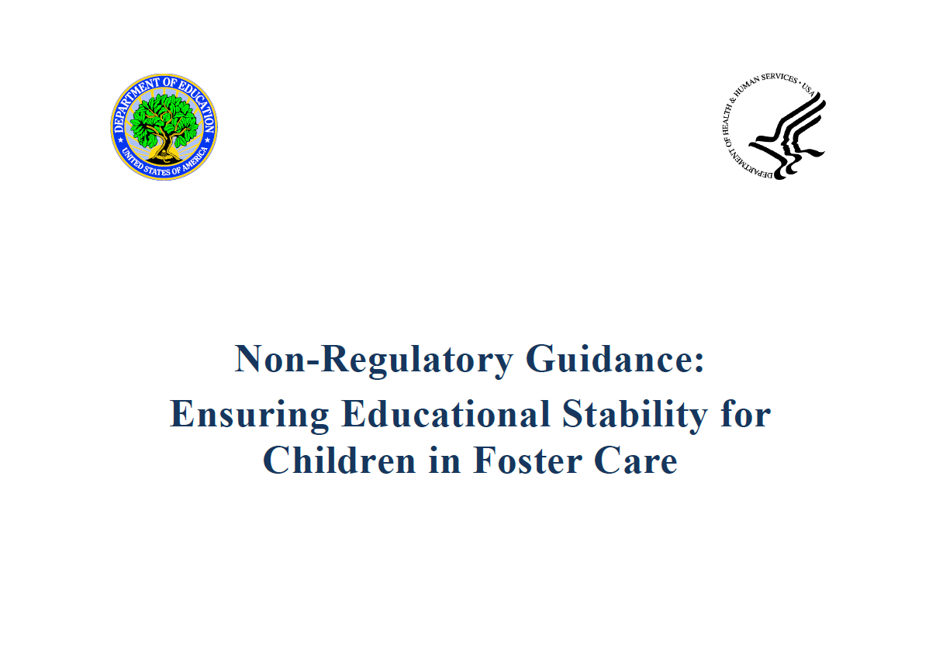
Access the joint guidance here:
http://www2.ed.gov/policy/elsec/leg/essa/edhhsfostercarenonregulatorguide.pdf

Slide 23




Insight from the Field
www.fostercareandeducation.org
Twitter: @FosterEdSuccess

Slide 24
insight from the field
What we have learned so far
Interagency collaboration is critical
Designated staff (POCs) can be the key to successful cross-agency communication
Data collection and information sharing drive reform
Investment in students in foster care improves strategies for all students
The court’s role in improved educational outcomes is critical

Slide 25
insight from the field
What needs to happen now
Help raise the visibility of the ESSA foster care provisions
Create a sense of urgency, given the timeline for implementation of key provisions (December 2016)
Encourage the quick identification of POCs
At state level: develop guidance for local jurisdictions on processes needed to support implementation
At local level: begin discussions about the written procedures that need to be in place to address transportation by December 2016
Determine need for additional technical assistance

Slide 26
Technical Assistance

Slide 27
Joint ED-HHS Webinar Series
Webinar Topic | Date
Points of Contact | August 17, 2016
Best Interest Determination & Immediate Enrollment | August 24, 2016
Transportation | August 31, 2016
Dispute Resolution and Collaboration | September 7, 2016
All webinars will be held from 2 – 3 PM ET

Slide 28

Questions about implementation?
Contact us!
SEAs & LEAs
Send questions to ED’s ESSA mailbox: essa.questions@ed.gov
CWAs
The Children’s Bureau (CB) provides technical assistance through the Capacity Building Center for States
  For additional information, reach out to your Center for States Liaison (https://capacity.childwelfare.gov/map)

Slide 29

Questions?

Slide 30
Thank you!

